Slide 1
FocusOn Webinar: Can Site-Neutral Payment Policies Help Control Costs?
11-08-16

Slide 2
The ERISA Industry Committee (ERIC) Antitrust Policy
As a reminder, all ERIC meetings and activities are to be conducted in full compliance with the ERIC Antitrust Policy. The antitrust laws prohibit competitors from agreeing on prices to be charged or otherwise taking steps that harm free and fair competition among them. While ERIC’s primary mission and activities are entirely consistent with the antitrust laws, if you have any concerns about a particular topic or discussion, please raise it with ERIC staff.

Slide 4
Hospital Outpatient Setting More Expensive
Milliman 2011 study on Medicare costs by site-of-service
$6,500 annualized higher chemo treatment costs in outpatient hospital cancer facilities versus independent community cancer clinics
$650 annualized higher out-of-pocket costs for Medicare beneficiaries
Sources:
Site of Service Cost Differences for Medicare Patients Receiving Chemotherapy, Milliman, October 2011

Slide 5
Differentials in Settings of Care
Service | Physician Office | HOPD
Chemotherapy | $136 | $390
Level II Echocardiogram | $188 | $453
E/M Visit (15 min) | $72 | $123
Cardiac imaging (3 day episode) | $655 | $2,078
MRI of the knee | $600 | $900
Basic colonoscopy | $625 | $1,383
Comprehensive metabolic panel | $13 | $37

Slide 6
Differentials in Setting of Care
March 2016 Study: National Estimates of Price Variation
by Site of Care
Examine price differential for individuals with employer-sponsored insurance by site of care for 7 commonly performed services at the national and regional level.

Slide 7
Differentials in Setting of Care
Key Findings:
Price variation based on site of service led to $1.9 billion in additional health care spending in 2013.
21% more for an office visit
258% more for chest radiography
44% increase in total health spending between 2008 and 2013

Slide 8
Differentials in Setting of Care
Between 2009 and 2012, Medicare beneficiaries receiving chemotherapy paid $4.05 million more in out-of-pocket costs.
A 2012 Avalere study on private payer costs by site-of-service found costs for chemotherapy in HOPDs were 76 percent higher than freestanding cancer clinics.
A GAO report from December 2015 found that Medicare payment rate for a mid-level E/M office visit was $51 higher when the service was performed in an HOPD instead of a physician office.

Slide 9
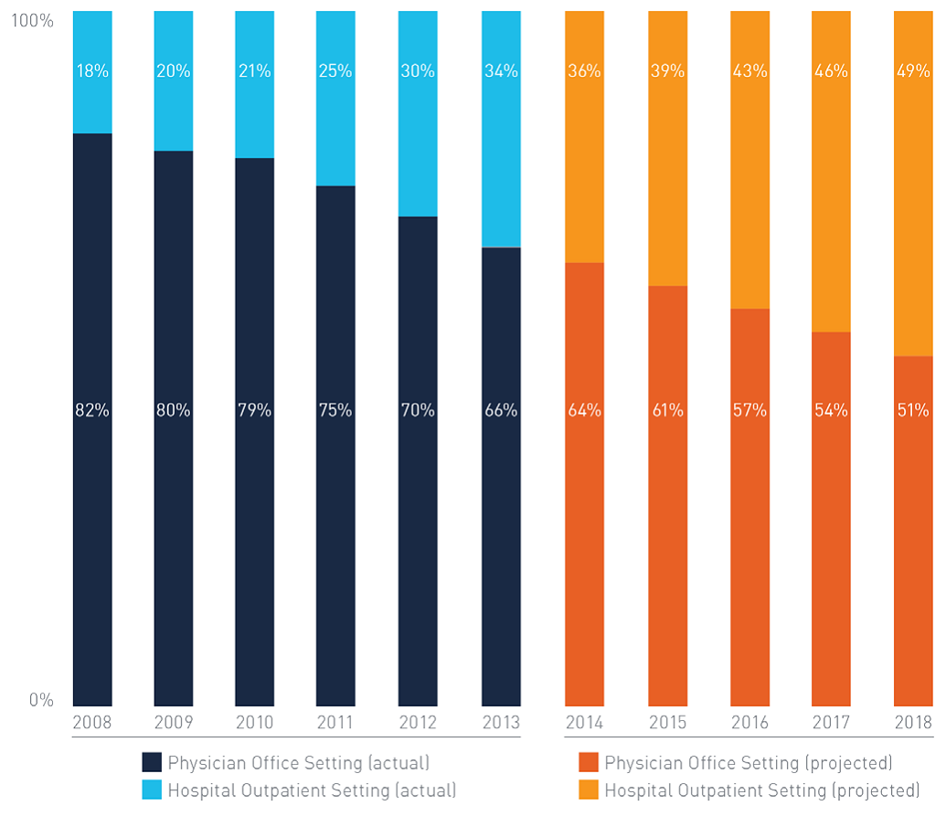
Shift of Care in Cancer

Slide 10
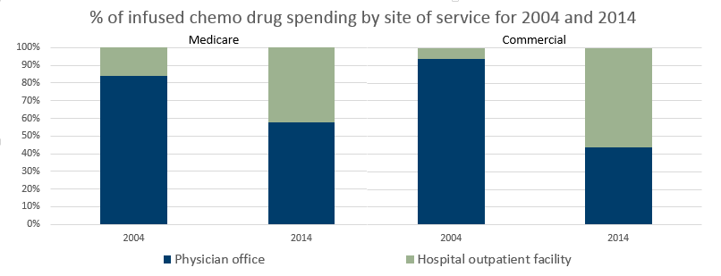
Medicare and Commercial Space

Slide 11
Between July 2012 and July 2015, the Number of Employed Physicians Increased to More Than 140,000

Slide 12
As of 2015, 1 in 4 Physicians is Employed by the Hospital

Slide 13
Site Neutral Payment Policy
Support payment parity across site of service in order to decrease Medicare and commercial spending, ensure patients receive the right care in the right setting, lower taxpayer and beneficiary costs, and increase patient access.
Supported by:
MedPAC, GAO, OIG
The Administration (Included in President’s FY16 Budget Proposal)
Policymakers
Bipartisan Budget Act of 2015 (HR 1314)
Energy & Commerce Committee call for feedback
Medicare Patient Access to Treatment Act (HR 2895) – Hearing May 2014
Alliance for Site Neutral Payment Reform (patient advocates, providers, employers and payers)

Slide 14
Site Neutral Payment Policy
Bipartisan Budget Act of 2015: Align payments for all newly acquired provider-based off campus HOPD’s with payments to physician practices.
Hospitals lobbying for carve outs, exemptions, grandfathering, date changes, regulatory relief, etc.
Helping Hospitals Improve Patient Care Act (H.R. 5273).
Exempts specific cancer hospitals from the site neutral payment provision.
Creates a “mid-build” exception to allow certain HOPDs that were under construction prior to November 2, 2015 to qualify for OPPS reimbursements.
Grandfathers HOPDs that submitted an attestation to CMS that they met the provider-based requirements by December 2, 2015.
Passed the House on June 7. Future uncertain in the Senate.

Slide 15
Measured Savings
MedPAC estimates suggest equalizing payments in 66 groups of services provided in freestanding offices and HOPDs would save Medicare beneficiaries $140 - $380 million in cost-sharing in one year
Equalizing payments in 12 groups of services in ASCs that are also done in OPDs would save Medicare beneficiaries $40 - $220 million in cost-sharing in one year
Bipartisan Budget Act of 2015 site neutral payment policy saved Medicare $9.3 billion
According to the President’s 2015 Budget, CBO estimates that enacting site neutral payment policies in off campus HOPDs could save Medicare $29.5 billion

Slide 16
Alliance Members
American Academy of Family Physicians
American College of Physicians
American Health Care Association
America's Health Insurance Plans
Blue Cross and Blue Shield Association
Brain Tumor Alliance
Community Oncology Alliance
Lung Cancer Alliance
Men’s Health Network
The National Restaurant Association
The US Oncology Network

Slide 17
www.siteneutral.org

