Slide 1
ERISA Advisory Council Lump Sum De-Risking Transaction Disclosures
The ERISA Industry Committee FocusON Call
May 14, 2015

Slide 2
Agenda
Background
GAO Report
ERISA Advisory Council
Approach to upcoming meeting

Slide 3
Background

Slide 4
Background
Pension De-risking: Reduce pension obligation volatility
Methods:
In-Plan Strategies
hedging
immunization
investing in annuity contracts
Settlement Strategies
lump sum offering
annuity certificate distributions
plan termination
Focus of Policy-Makers:
Settlement Strategies, especially lump sum offers

Slide 5
GAO Report

Slide 6
GAO Report
Overview:
Reps. Levin and Miller requested report on lump sum windows
Reviewed sample disclosures
Interviewed participants
Concluded that key information was missing

Slide 7
GAO Report
Recommendations:
Sponsors should notify DOL when lump sum windows are offered
Number and category of participants
Examples of disclosure materials
Treas. should review lookback interest rate rules
Treas. should implement process to update mortality tables
Disclosure materials should contain additional information

Slide 8
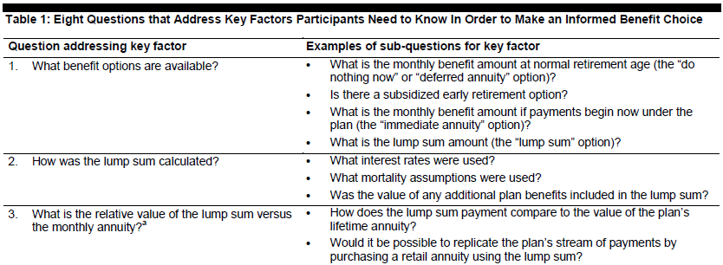
GAO Report
GAO list of items to include in disclosures:

Slide 9
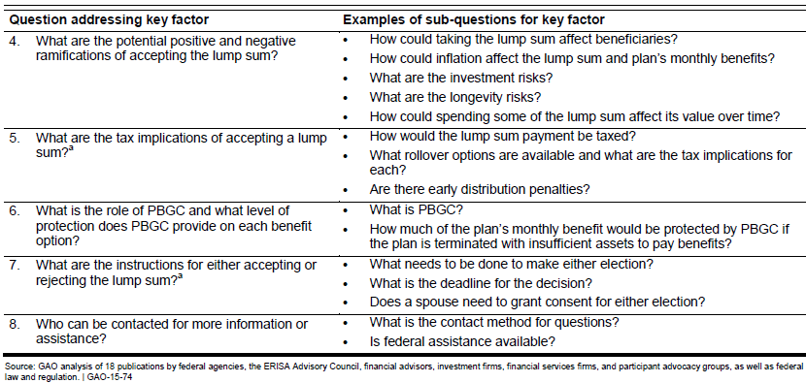
GAO Report
GAO list of items to include in disclosures, cont.:

Slide 10
ERISA Advisory Counsel

Slide 11
ERISA Advisory Counsel
2013 Hearings:
Addressed de-risking generally
Many recommendations focused on increased disclosure

Slide 12
ERISA Advisory Counsel
Upcoming Hearing–May 28, 2015:
Focus on developing model disclosure
Key topics
Elderly/reduced cognitive ability disclosures
Effect of lump sum on Medicaid eligibility
Media for communications
Longevity and investment risk
Annuity from DB plan vs. commercial annuity
Cybersecurity and cybertheft

Slide 13
ERISA Advisory Counsel
Approaches for Upcoming Hearing:
Key principles:
need for employer flexibility
DB plan sponsors should not be further burdened
Any model disclosure needs to be concise
Need for consistency with Treas./IRS Rules
existing disclosures highly regulated (e.g., relative value disclosures)
What not to require:
Individualized estimates of annuity purchased in commercial market
Individualized assessment of participant’s circumstances (such as age)

Slide 14
ERISA Advisory Counsel
Potential elements of model disclosure:
Investment Responsibility and Risk. E.g., If you decide to take a lump sum distribution, you will be responsible for the investment of your benefits. The amount of benefits you receive during your retirement will depend on the performance of the investment(s) you choose.
Longevity Risk. E.g., If you decide to take a lump sum distribution, you will be responsible for managing your distribution amount to provide retirement income throughout your retirement. You could exhaust your benefit before your die. By contrast, an annuity benefit is guaranteed to provide a payment throughout your life and, depending on the option you choose, the life of your spouse.

Slide 15
ERISA Advisory Counsel
Potential elements of model disclosure (cont’d):
Interest and Cost-of-Living Risk. E.g., If you decide to take an annuity, the amount of your monthly annuity will be fixed for the rest of your life (and, depending on the form you elect, the life of your spouse). Your monthly amount is not adjusted by interest or to account for increases in the cost of living. Accordingly, payments made later may be worth less than payments made today.
Annuity Paid by Plan vs. Annuity Purchased in Market. E.g., Typically, you will receive a greater monthly annuity benefit by electing to receive an annuity from a defined benefit pension plan than if you elect to receive an equivalent lump sum distribution and then purchase an annuity benefit yourself directly from an insurance company.

Slide 16
Questions?
Robert Newman
202-662-5125
rnewman@cov.com

